Slide 1

Training Neural Networks & Optimization
Explore the fundamental processes behind teaching neural networks to learn and improve performance.

Slide 2
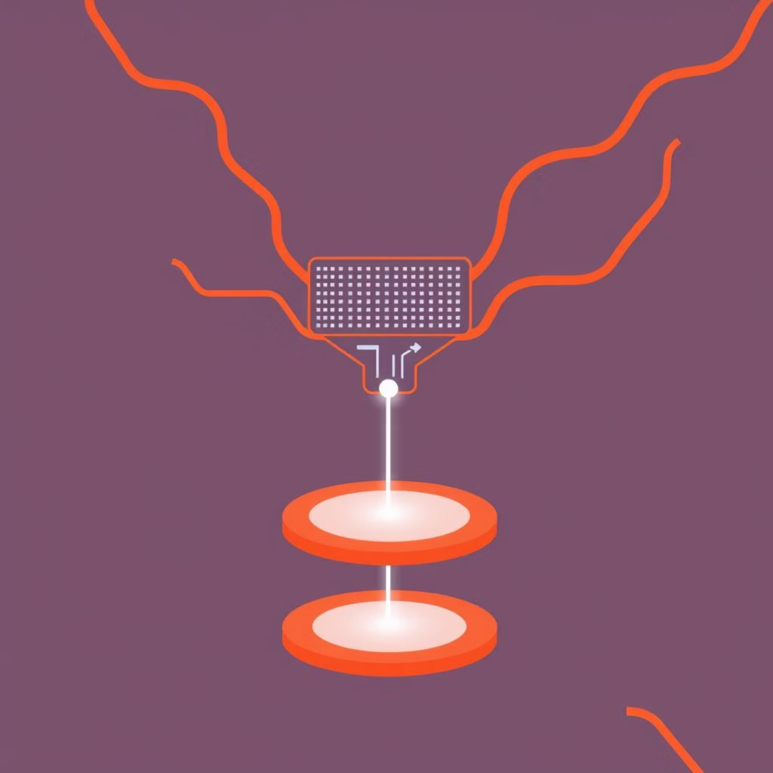
What is Backpropagation?
Learning Algorithm
The core method for neural network training.
Error Measurement
Calculates how far off predictions are.
Weight Adjustment
Fine-tunes connections to reduce errors.

Slide 3
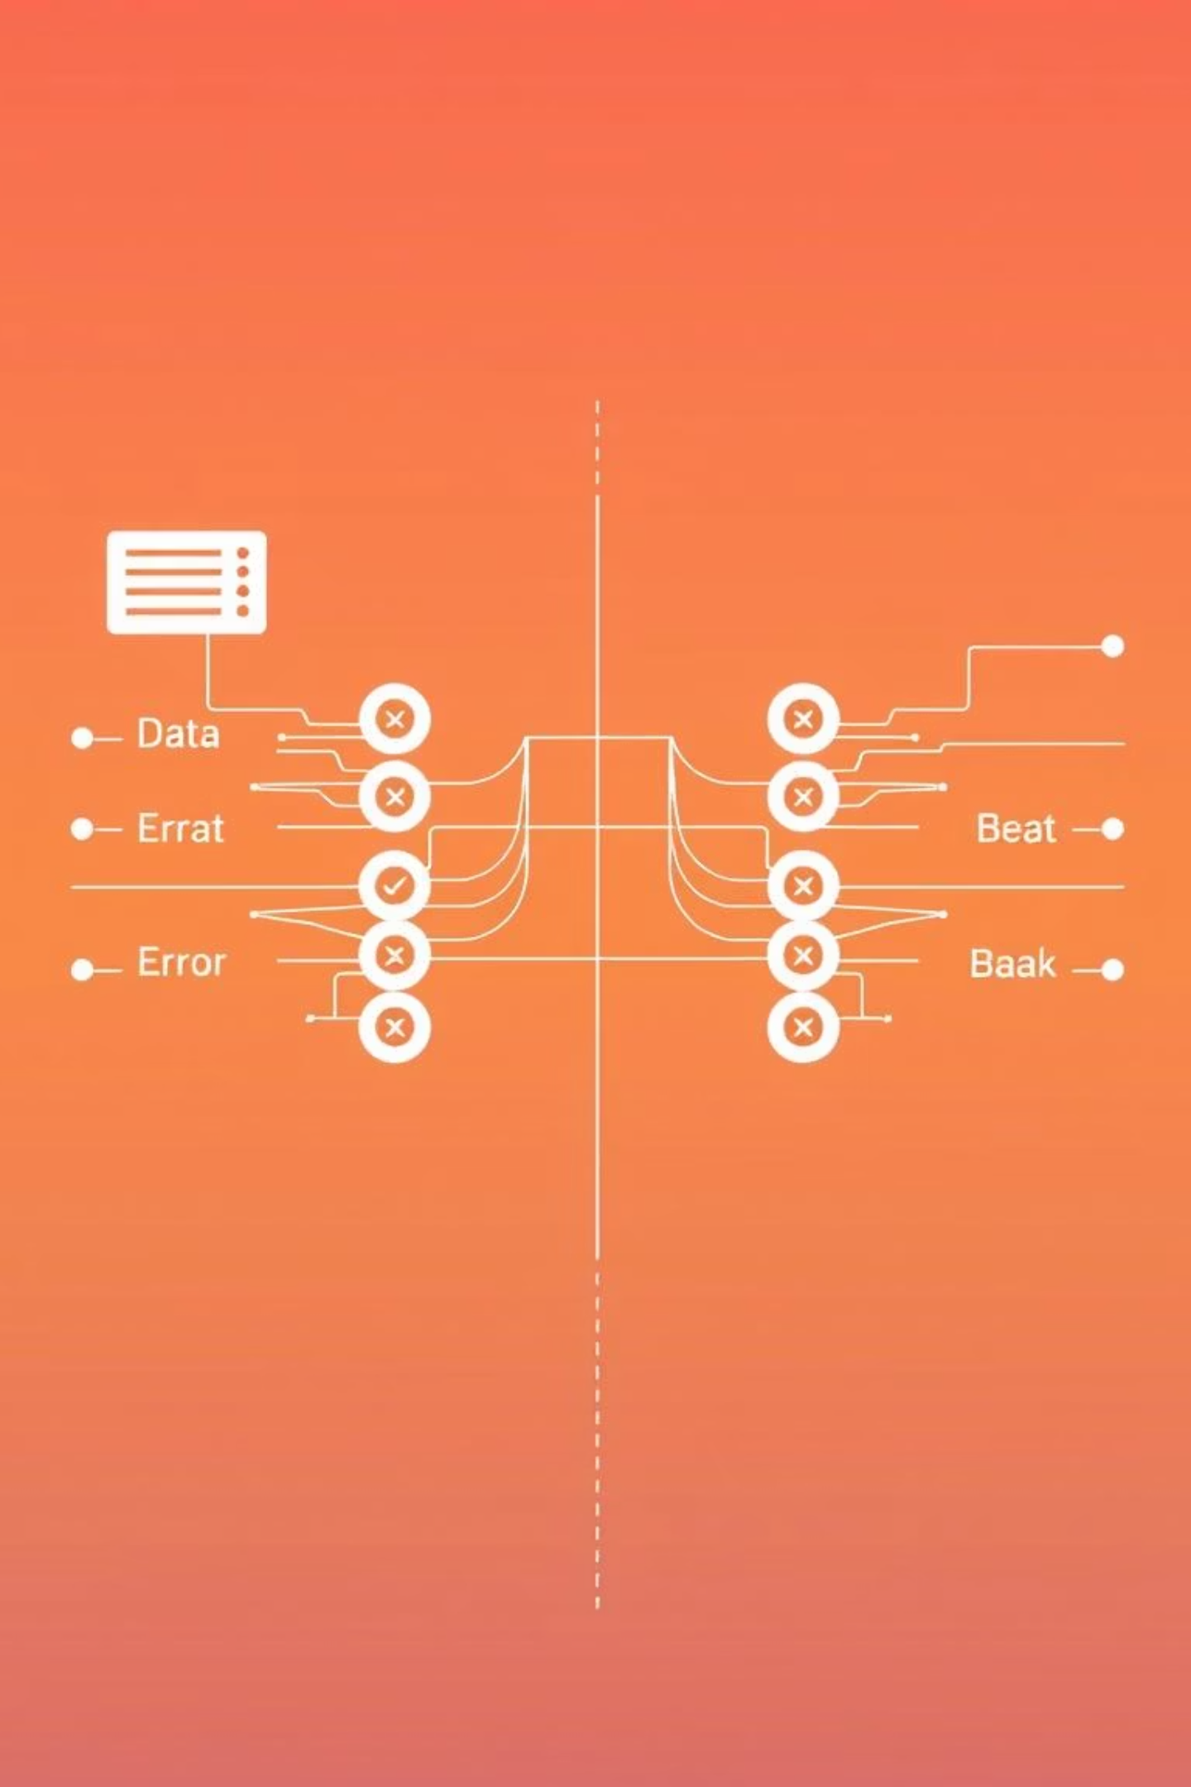
How Backpropagation Works
Forward Pass
1
Input data moves through the network to generate an output.
Calculate Loss
2
Compare predicted output with the actual target.
Backward Pass
3
Error signals are sent back through the network.
Update Weights
4
Adjust network connections based on error signals.

Slide 4


Introduction to Gradient Descent
An optimization algorithm that helps minimize the "loss" or error in a neural network. It iteratively adjusts the network's weights to find the lowest point of the loss function.
w: network weights
η: learning rate
∇L: gradient of the loss function

Slide 5

Understanding the Gradient
Slope of Loss
Direction & Magnitude
Indicates the steepest direction of the error curve.
Tells how much and in which way to change weights.
Minimize Error
The ultimate goal is to reach the lowest error point.

Slide 6
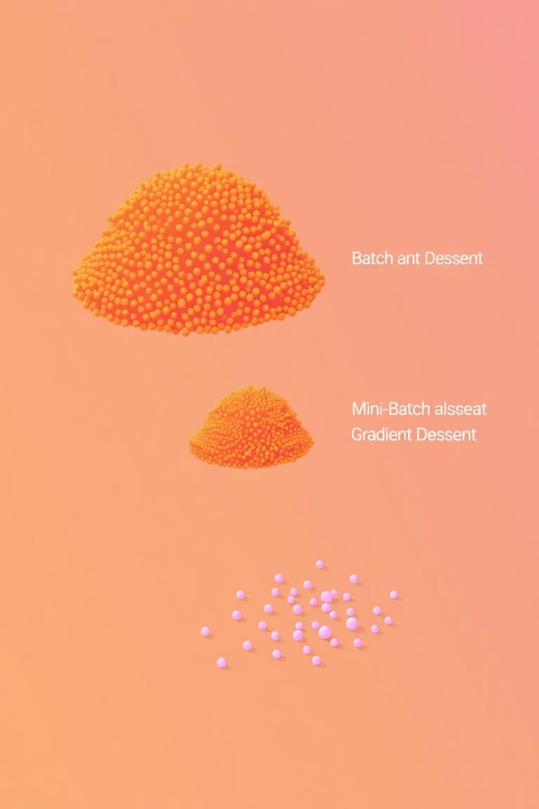

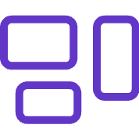

Variants of Gradient Descent
Different approaches to updating weights, each with trade-offs.
Batch GD
Uses all data for one update.
Stochastic GD
Updates per single data point.
Mini-Batch GD
Updates per small group of data.

Slide 7



Batch Gradient Descent
Calculates the gradient using the entire training dataset before updating the weights. This leads to a very stable convergence.
N: Total number of training samples. Each L_i is the loss for one sample.
Stable, but can be very slow for large datasets.

Slide 8





Stochastic & Mini-Batch Gradient Descent
Stochastic GD
Mini-Batch GD
Update per sample: Weights updated after processing just one training example.
Update per small batch: Updates weights after processing a small subset of training data (e.g., 32-256 samples).
Noisy updates, but very fast.
Balances speed and stability, widely used.

Slide 9

Learning Rate: Key Hyperparameter
The learning rate (η) controls the size of the steps taken during weight updates.
High Learning Rate
May overshoot the optimal solution, causing instability.
Low Learning Rate
Leads to very slow convergence, extending training time.
Finding the right balance is crucial for efficient training.

Slide 10

Summary & Takeaways
Backpropagation
The engine for calculating error gradients.
Gradient Descent
The optimizer for adjusting network weights.
GD Variants
Batch, Stochastic, Mini-Batch offer different speeds/stabilities.
Learning Rate
Crucial for effective and efficient training.
Mastering these basics unlocks the power of neural networks!

